Slide 1

Gaussian Elimination
Prianka Mandal
Lecturer
Daffodil International University

Slide 2
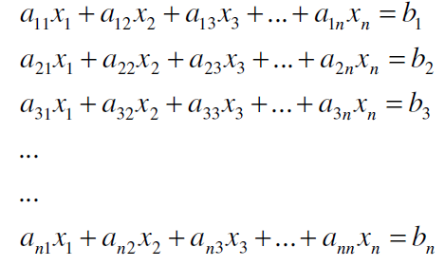
Introduction
One of the most popular techniques for solving simultaneous linear equations is the Gaussian elimination method.
The approach is designed to solve a general set of equations and unknowns

Slide 3
Two steps of Gaussian Elimination
Forward Elimination of Unknowns:
In this step, the unknown is eliminated in each equation starting with the first equation. This way, the equations are reduced to one equation and one unknown in each equation.
Back Substitution:
In this step, starting from the last equation, each of the unknowns is found.

Slide 4
Two types of Gaussian Elimination
Gaussian Elimination
In this method, maximum of the selected column in forward elimination stage, has to be found out.
Gaussian Elimination with partial pivoting
In this method, maximum of the selected column in forward elimination stage has to be found out.

Slide 5

Forward Elimination of Unknowns:
In the first step of forward elimination, the first unknown, x₁ is eliminated from all rows below the first row.
The first equation is selected as the pivot equation to eliminate x₁.
So, to eliminate x₁ in the second equation, one divides the first equation by a₁₁ (hence called the pivot element) and then multiplies it by a₂₁.
This is the same as multiplying the first equation by a₂₁ / a₁₁ to give

Slide 6


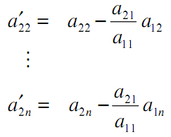
Forward Elimination of Unknowns(cont.):
Now, this equation can be subtracted from the second equation to give
Or
where,

Slide 7
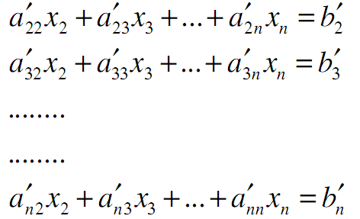
Forward Elimination of Unknowns(cont.):
This procedure of eliminating , is now repeated (with the first equation as pivot) for the third equation to the n^{th} equation to reduce the set of equations as
This is the end of first step

Slide 8
Forward Elimination of Unknowns(cont.):
Now for the second step of forward elimination, we start with the second equation as the pivot equation and a`₂₂ as the pivot element.
So, to eliminate X₂ in the third equation, one divides the second equation by a`₂₂ (the pivot element) and then multiply it by a`₃₂.
This is the same as multiplying the second equation by a`₃₂ / a`₂₂ and subtracting it from the third equation.
This makes the coefficient of X₂ zero in the third equation.

Slide 9
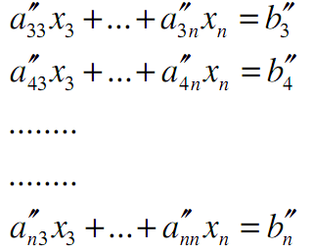
Forward Elimination of Unknowns(cont.):
The same procedure is now repeated for the fourth equation till the n^{th} equation to give

Slide 10
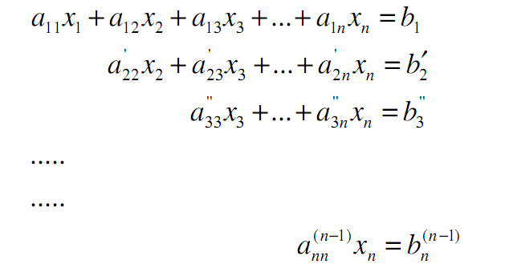
Forward Elimination of Unknowns(cont.):
The next steps of forward elimination are conducted by using the third equation as a pivot equation and so on.
There will be a total of (n-1) steps of forward elimination.
At the end of (n-1) steps of forward elimination, we get a set of equations that look like

Slide 11

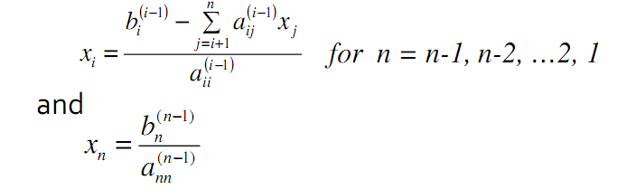
Back Substitution
Now the equations are solved starting from the last equation as it has only one unknown.
Then the second last equation, that is the (n-1)th equation, has two unknowns: xn and xn+1 and , but xn is already known. This reduces the (n-1)th equation also to one unknown. Back substitution hence can be represented for all equations by the formula

Slide 12
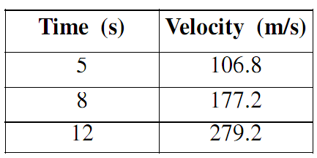
Example
The upward velocity of a rocket is given at three different times in Table 1.
The velocity data is approximated by a polynomial as
Find the values of b1, b2 and b3 using the Gauss elimination method. Find the velocity at t = 6, 7.5, 9, 11 seconds.

Slide 13
Example
The three equations can be written as
25 b1 + 5 b2 + b3 = 106.8 …. …. …. …. … …. (1)
64 b1 + 8 b2 + b3 = 177.2 …. …. …. …. … …. (2)
144 b1 + 12 b2 + b3 = 279.2 …. …. …. …. … …. (3)
Pivoting a11 in equation (1) we can eliminate b1 from equation (2) and (3). The changed equation becomes,
25 b1 + 5 b2 + b3 = 106.8 … … .. … (4)
- 4.8 b2 - 1.56 b3 = - 96.28 … … .. …. (5)
- 16.8 b2 - 4.76 b3 = - 335.968 .. .. .. .. .. (6)

Slide 14
Example
Now, with a22’ as pivot element we can eliminate b2 from equation (6), the previous three equation now become,
25 b1 + 5 b2 + b3 = 106.8 … … .. … (7)
- 4.8 b2 - 1.56 b3 = - 96.28 … … .. …. (8)
0.7 b3 = 0.76 … ... ... ... .... (9)
BACK SUBSTITUTION
From equation (9), b3 = 1.08571
From equation (8), using the value of b3, b2= 19.6905
From equation (7), using the value of b2 & b3, b1= 0.290472
Hence the equation for the velocity is v(t)=b1+b2t+b3t 2
The velocity at 6,7.5, 9 and 11 can be found by putting the time value in the equation.

Slide 15

Partial Pivoting
To avoid division by zero as well as to reduce round off error gauss elimination method with partial pivoting is used.
The two methods are the same, except in the beginning of each step of forward elimination, a row switching is done based on the following criterion.
Criteria: If there are n equations, then there are n-1 forward elimination steps. In the kth step of forward elimination, one finds the elements of the kth column below k-1 row
Then, if the maximum of these values is |apk| in the pth row, then switch rows p and k.
The other steps of forward elimination are the same as the Gauss elimination method.
The back substitution steps stay exactly the same as the Gauss elimination method.

Slide 16
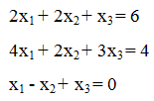

Example: Partial pivoting
Consider the set of equations
Step 1: the absolute values the elements in the first column are 2, 4 and 1. Among them 4 is the largest. so row 2 (largest) and row 1(pivot) has to be interchanged.
Then eliminate the first variable from equations as explained earlier. At the end of first step, the equations become

Slide 17
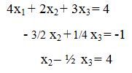
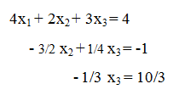
Example: Partial pivoting
Step 2: Among 1 and 3/2, 3/2 is the largest and since 3/2 is in the 3rd row, so row 3 (largest) and row 2 (pivot) has to be interchanged and the next process is as usual.
At the end of second step, the equations become
The solution is: x₃ = -10, x₂ = -1, x₁ =9

Slide 18
Exercises
Solve the following equation by Gauss elimination method:
2x+4y-6z = -4
x+5y+3z = 10
x+3y+2z = 5

Slide 19
Exercises (Gaussian Elimination)
1. 0.3x1 + 0.52x2 + x3 = −0.01
0.5x1 + x2 + 1.9x3 = 0.67
0.1x1 + 0.3x2 + 0.5x3 = −0.44
2. 4x1 + x2 − x3 = −2
5x1 + x2 + 2x3 = 4
6x1 + x2 + x3 = 6

Slide 20
Exercises (Gaussian Elimination with partial pivoting)
2x1 − 6x2 − x3 = −38
− 3x1 − x2 + 7x3 = −34
− 8x1 + x2 − 2x3 = −20

Slide 21
Thank you!!!

